Slide 1


FINANCIAL
WEEK 8 CASE STUDY
ANALYSIS

Slide 2


OBJECTIVE
The objective is to develop a comprehensive analytical solution using Power BI and DAX to assess credit card usage and financial metrics for a banking institution. The analysis focuses on calculating running totals, moving averages, and growth rates to monitor financial performance across customer segments. It further aims to evaluate behavioral patterns through key performance indicators that track credit utilization, transaction inactivity, and flags for at-risk clients. By segmenting customers based on revolving balances and delinquency metrics, the model will generate composite risk scores and predictive alerts to identify high-risk profiles. These insights will empower the institution to enhance customer retention strategies, mitigate credit misuse, and fine-tune financial product offerings, ultimately improving overall portfolio health and operational efficiency.
I

Slide 3


PROBLEM STATEMENTS
Running Total of Credit Card Transactions
Calculate the 4-week moving average of the creditLimit for each client.
Calculate the mom% growth and wow% growth on transaction amount.
Calculate Customer Acquisition Cost (CAC) as a Ratio of Transaction Amount.
Calculate the yearly average of avg_utilization_ratio for all clients.
Calculate the percentage of Interest_Earned compared to Total_Revolving_Bal for each client.
Calculate Top 5 Clients by Total Transaction Amount.
Identify clients whose Avg_Utilization_Ratio exceeds 80%.
Customer Churn Indicator: Create a KPI that flags clients who have not made any transactions (Total_Trans_Amt = 0) in the last 6 months.
Delinquency Rate: Calculate the percentage of clients with Delinquent_Acc > 0.
Credit Risk Score: Create a score for each client based on their Avg_Utilization_Ratio, Delinquent_Acc, and Total_Revolving_Bal.
Income vs Credit Limit Correlation: Show the correlation between Income and Credit_Limit for all clients.
Average Customer Satisfaction Score by Credit Card Category: Calculate the average Cust_Satisfaction_Score by Card_Category.
Loan Approval vs Credit Limit: Analyze how Credit_Limit affects Personal_loan approval by calculating the average credit limit for clients with and without loans.
High Risk Clients Flag: Create a flag for clients whose Total_Revolving_Bal exceeds 90% of their Credit_Limit and who have a high Avg_Utilization_Ratio.

Slide 4


Date table creation
I

Slide 5
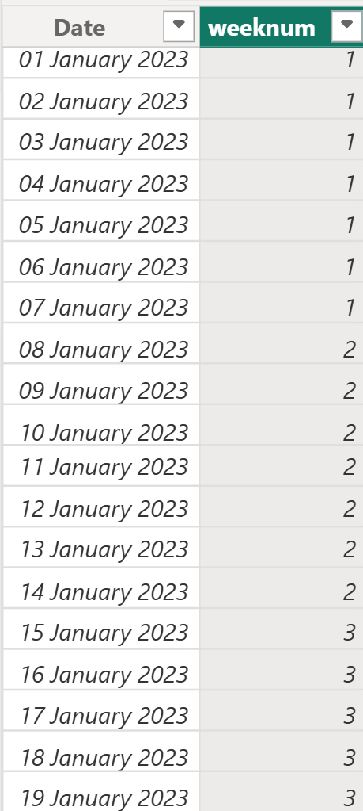
I

Slide 6
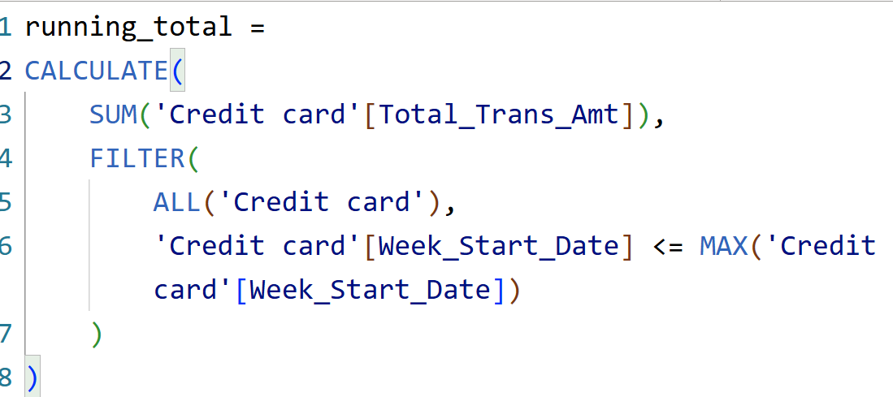
Q
Running Total of Credit Card Transactions

Slide 7

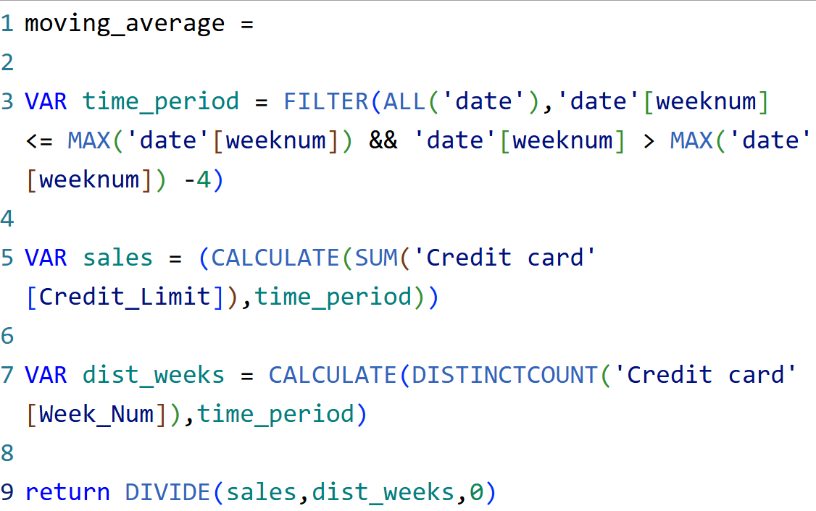

Q
Calculate the 4-week moving average of the credit limit for each client
I

Slide 8

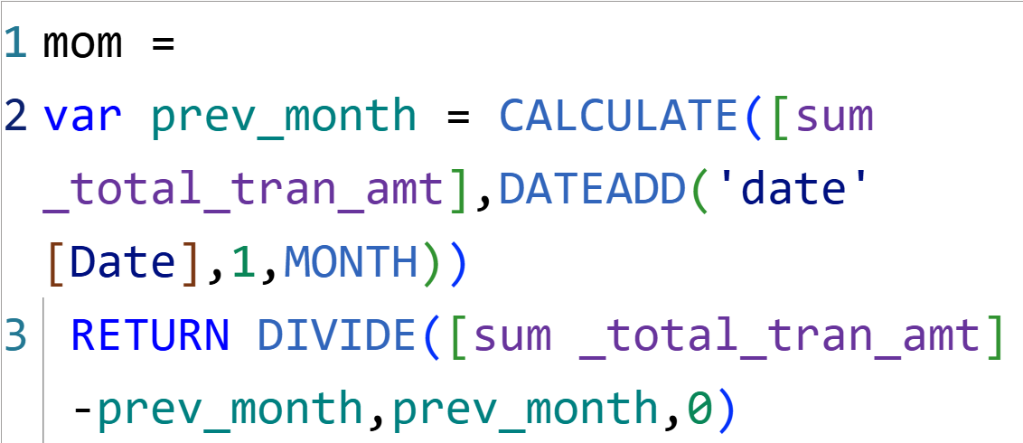

Q
Calculate the mom% growth on transaction amount

Slide 9
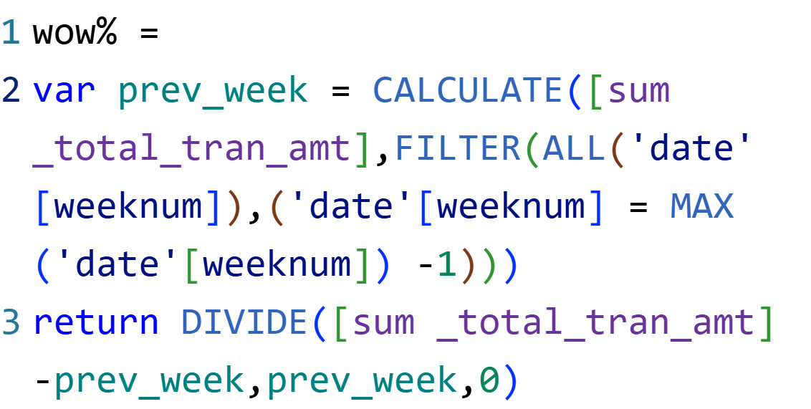
Q
Calculate the wow% growth on transaction amount

Slide 10


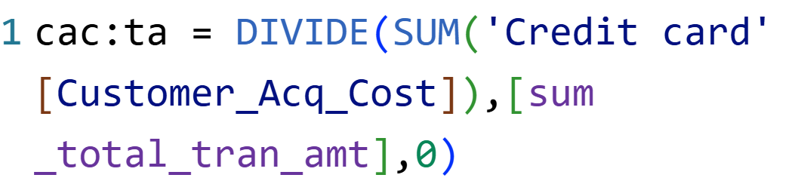
Q
Calculate Customer Acquisition Cost (CAC) as a ratio of Transaction Amount

Slide 11


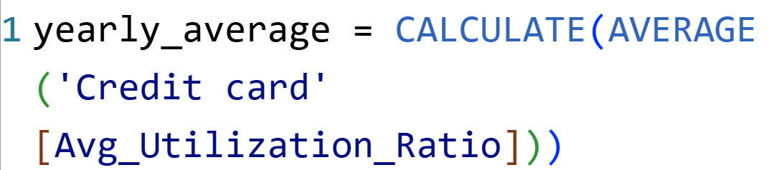
Q
Calculate the yearly average of avg_utilization_ratio for all clients

Slide 12
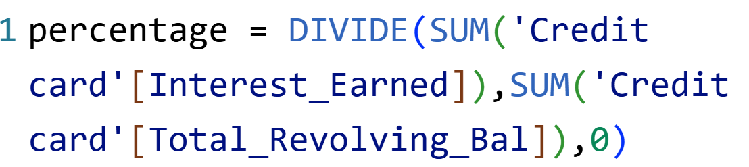
Q
Calculate the percentage of Interest_Earned compared to Total_Revolving_Bal for each client

Slide 13
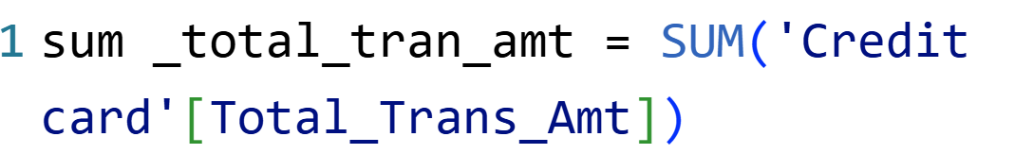
Q
Calculate Top 5 Clients by Total Transaction Amount

Slide 14
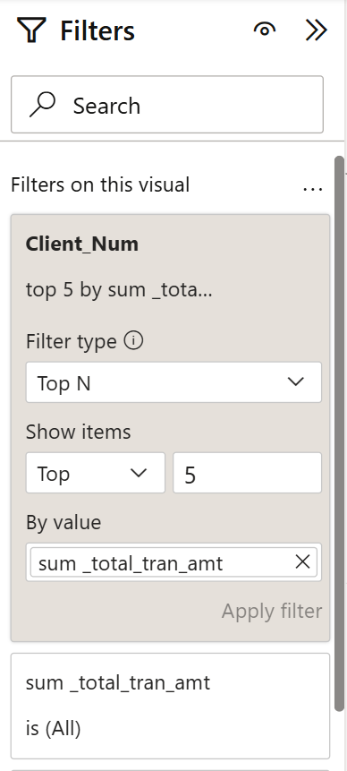


Slide 15


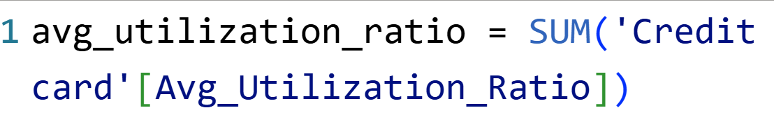
Identify clients whose Avg_Utilization_Ratio exceeds 80%?
Q

Slide 16
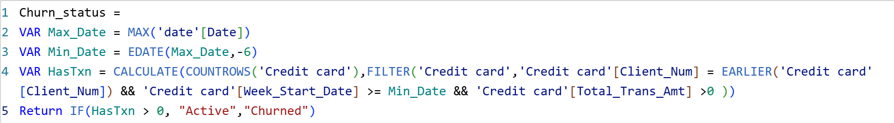
Q
Create a KPI that flag clients who have not made any transactions in last 6 months
I

Slide 17
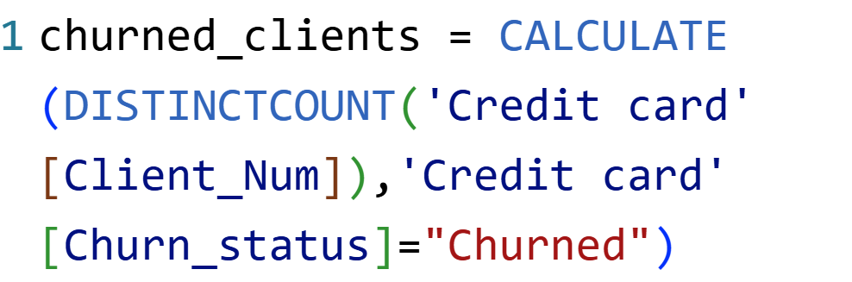



Slide 18


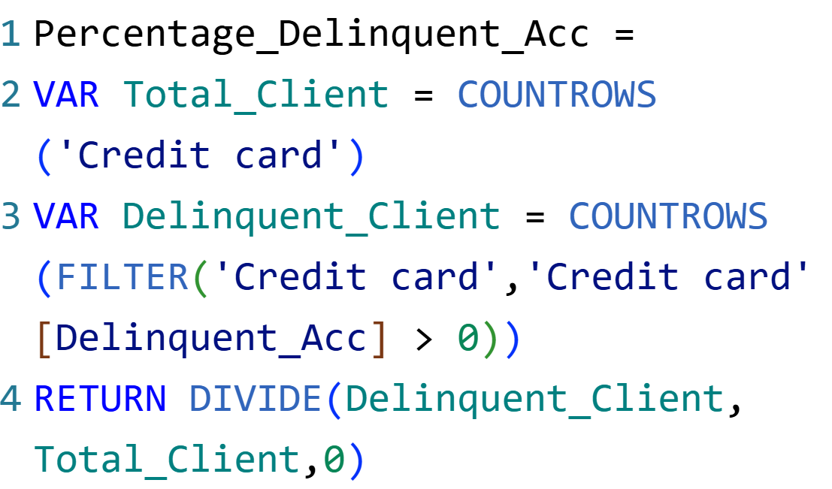
Calculate the percentage of clients with Delinquent_Acc > 0
Q

Slide 19
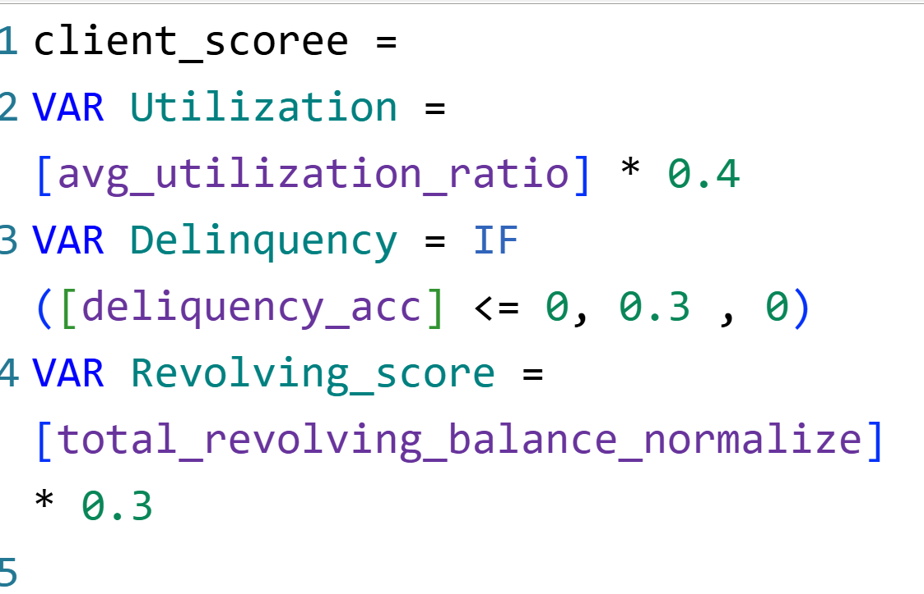
Q
Create a score of each client based on their Avg_utilization_ratio, Delinquent Acc, and Total_Revolving_Balance

Slide 20
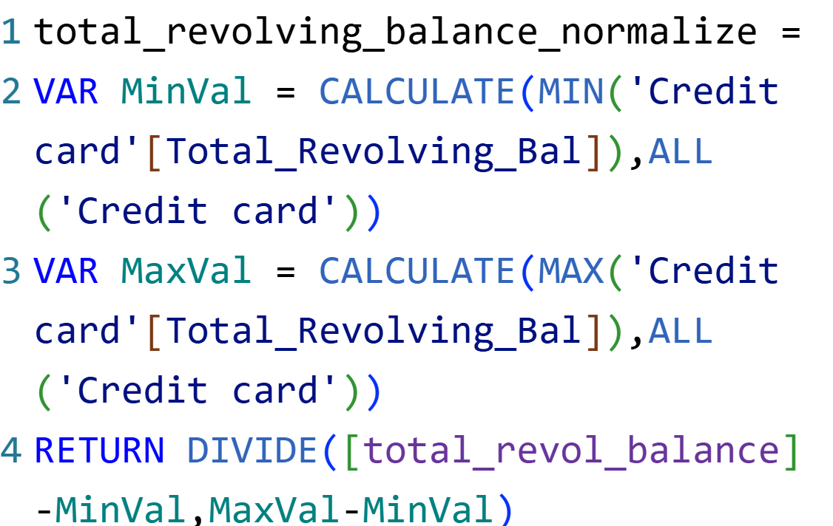

Slide 21
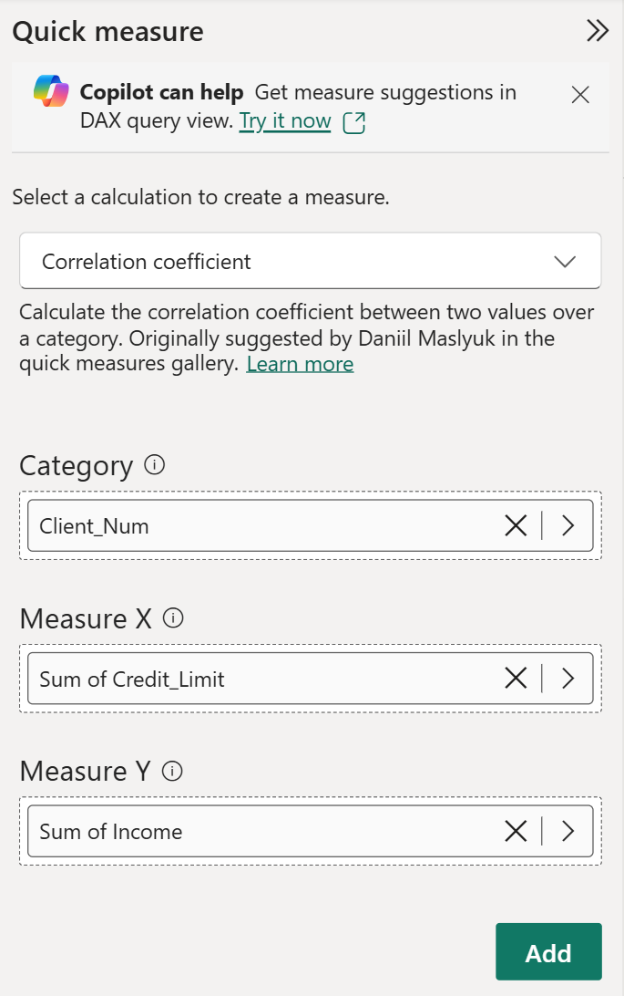
Show a correlation between Income and Credit Limit of all clients
Q

Slide 22
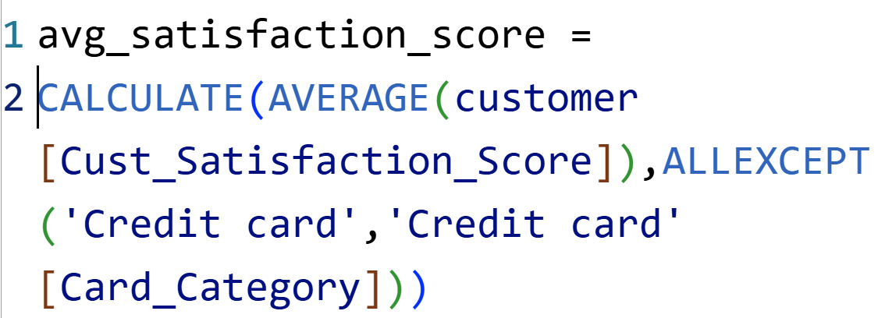
Calculate the average of Cust_Satisfaction_Score by Card_Category
Q

Slide 23
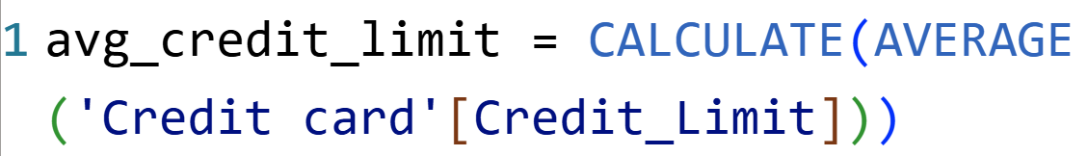
Q
Analyze how credit limit affect personal loan approval by calculating the average credit limit for clients with without loan

Slide 24
Q
Create a flag for clients whose Total_Revolving_Bal exceeds 90% of their Credit Limit and who have a high Avg_Utilization_Ratio

Slide 25
KEY INSIGHTS
Running Total of Total Transaction Amount is ₹4,55,33,021.
Month over Month growth for Year 2023 is 10.49%.
Week over Week growth for Year 2023 is 5981.80%.
Yearly average of Avg_Utilization_ratio for all clients is 0.27.
Silver and Blue have the same Avg_Cust_Satisfaction_Score by Card Category is 3.2.
Percentage of clients with Delinquent Acc is 6.06%.
Percentage Interest_Earned compared to Total_Revolving_Balance for each client is 66.63%.
I

Slide 26
KEY INSIGHTS
Customer Acquisition Cost as a Ratio of Transaction Amount is 2.18%.
Clients who have not made any transaction in last 6 months is 49.25%.
Avg_Credit_Limit of clients having Personal Loan is ₹ 8.56K.
Avg_Credit_Limit of clients not having Personal Loan is ₹ 8.65K.
Generally clients having loan and not having loan have an impact on Credit Limit but here it has not major impact on Credit Limit.
I

Slide 27

THANK YOU
Submitted By – Yash Totlani

